Slide 1
Fishy Business: estimating the impact of irregular and unsustainable fishing of distant-water fishing fleets in Ecuador, Ghana, Peru, the Philippines and Senegal
Method Guide to use the data and algorithm repository

Slide 2
Data repo
First sheet: Index of data tables included in the report
Rest of sheets: Individual table data

Slide 3
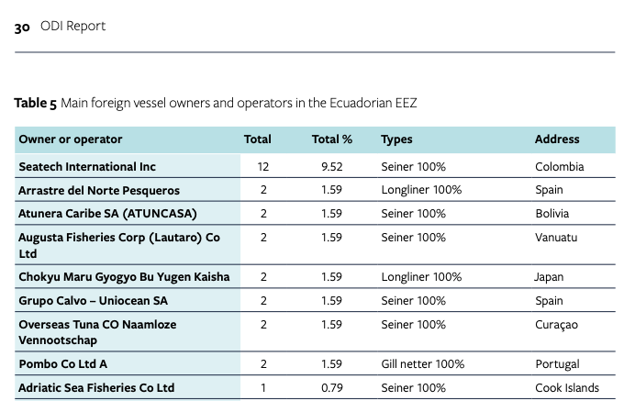
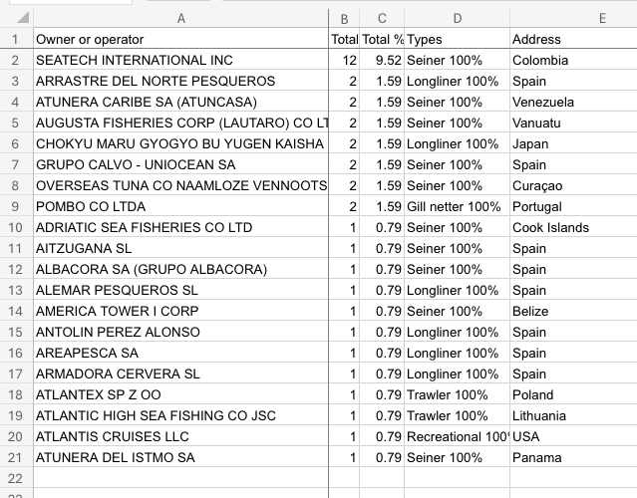
Sample: Table 5 Main foreign vessel owners and operators in the Ecuadorian EEZ

Slide 4
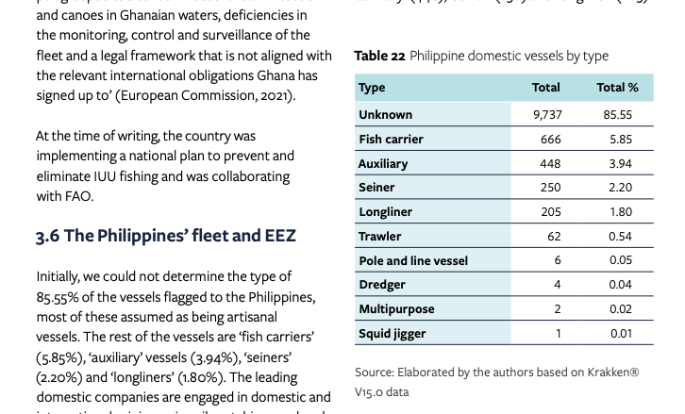
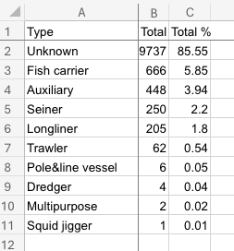
Sample: Table 22 Philippine domestic vessels by type

Slide 5
File organization of prediction tools
predict.py:
This script utilizes the models stored in the "models" folder to evaluate the AIS files located in the "data_path" directory. The script then saves the output predictions in the "predictions_path" folder.
Map_PredictionAsColor.ipynb:
This Jupyter Notebook assists in plotting the positions of AIS data and visualizing the probability of a boat engaging in fishing activities on Google Maps. It serves as a helpful tool for spatial analysis and visualization.
utils:
This directory contains several auxiliary files that include functions utilized for various purposes within the project. These functions aid in data preprocessing, visualization, or other tasks required by the project.
models:
This directory houses the trained machine learning models used in the prediction process. These models are trained on historical AIS data and are essential for making predictions about boat activities.
data_path:
The "data_path" directory contains the AIS data files required for model evaluation. These files typically include information such as timestamps, coordinates, and other relevant data about boat movements.
predictions_path:
The "predictions_path" folder serves as the destination directory for storing the results generated by the "predict.py" script. These results include predictions made by the models regarding boat activities based on the provided AIS data.

Slide 6
Usage for prediction
predict.py:
In order to use this script, it must be called with:
> python3 predict.py
This script allows parameters, as can be listed with
> python3 predict.py --help
optional arguments:
-h, --help show this help message and exit
--data_path DATA_PATH
Path where the models are located.
--predictions_path PREDICTIONS_PATH
Path for predictions.
--model_1 MODEL_1 Path to model maneuver_1 model.
--model_2 MODEL_2 Path to model maneuver_2 model.
--model_3 MODEL_3 Path to model maneuver_3 model.
--model_4 MODEL_4 Path to model maneuver_4 model.

Slide 7
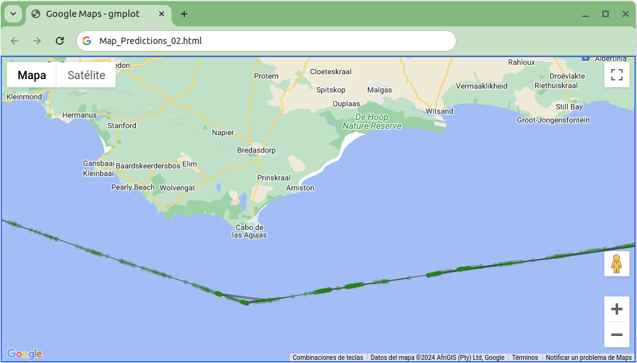
Usage for visualization
Map_PredictionAsColor.ipynb:
This Jupyter Notebook requires a google api key for google maps, replace "--GMAPS-KEY--" with your own.
Define the mmsi
Select one of the probability columns ("p1", "p2", "p3", "p4")
Set the path for the predictions
The notebook will generate an html file with a map for each file containing the mmsi defined

Slide 8
Thanks!

